Slide 1
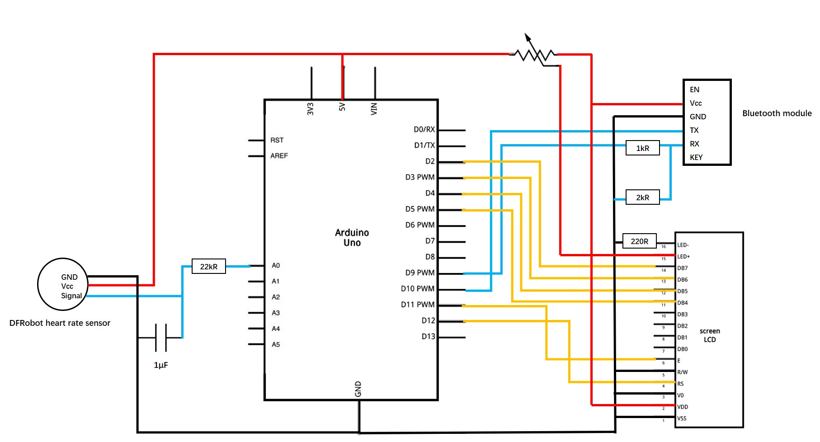
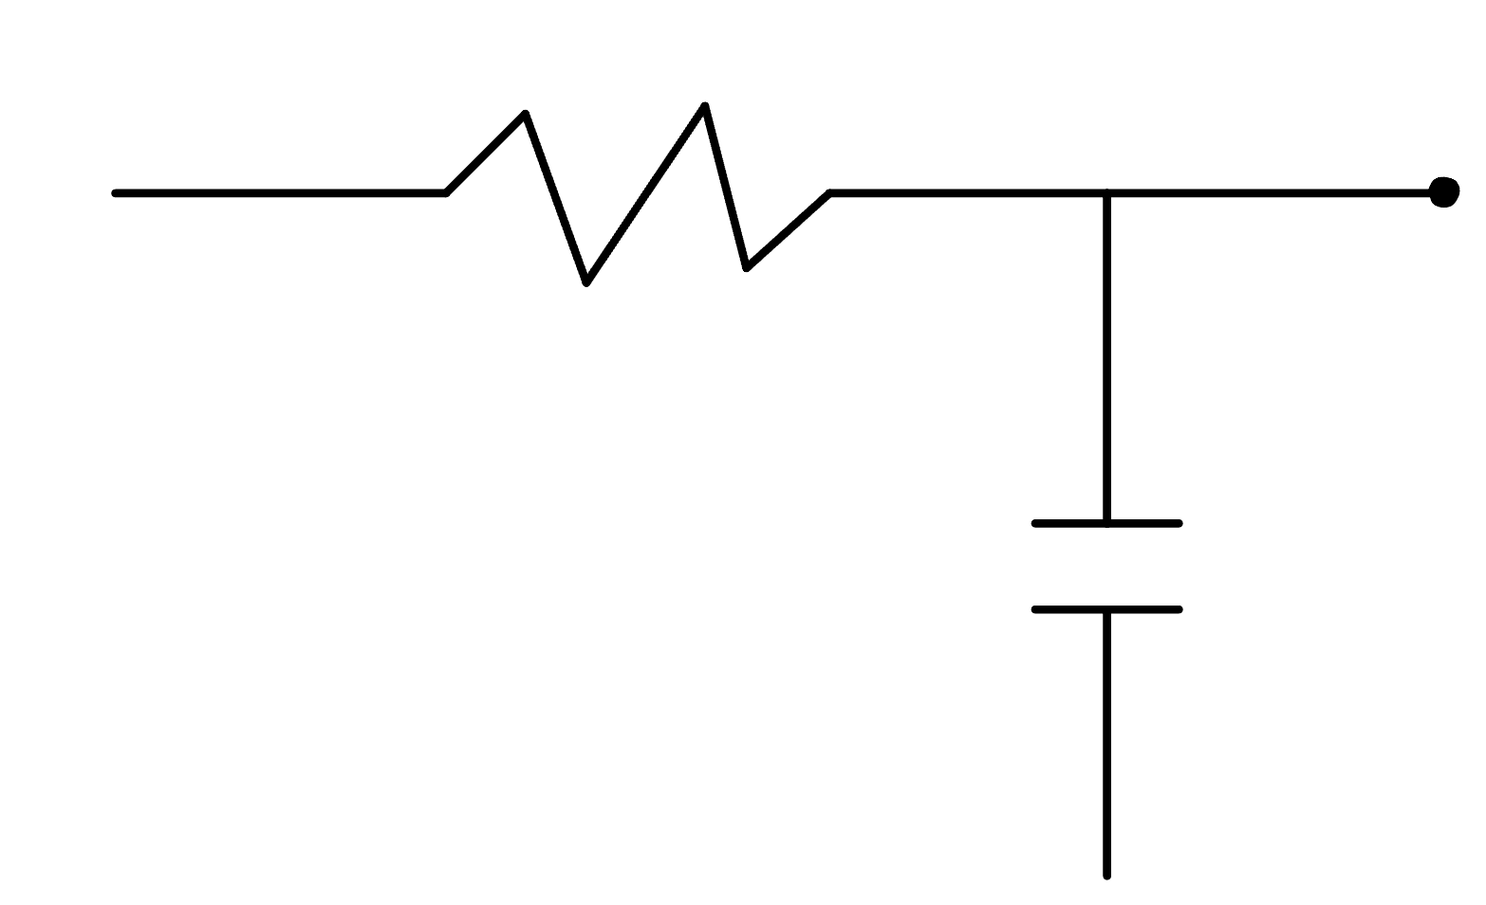
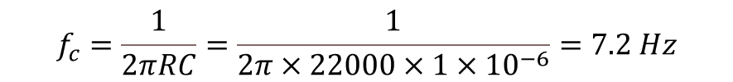



Measuring Heart Rate with Pulse Sensor
Universal Asynchronous Receiver Transmitter (UART) is found in HC-05 Bluetooth module - is set to a 3.3-5V level
Serial communication between Arduino Uno and computer via USB
LCD Display operates on parallel interface protocol - Uses multiple data pins
Low Pass Filtering:
$$22kΩ$$
$$V_{out}$$
$$f_{c}=\frac{1}{2πRC}=\frac{1}{2π×22000×1×{10}^{−6}}=7.2 Hz$$
Input: Amount of light reflected by blood
Output: heart rate showed on serial monitor, on LCD display, and sent to a phone via Bluetooth
$$1µF$$
Trade-off between response-time and filtering
Lower cut-off frequency results longer time constants

Slide 2
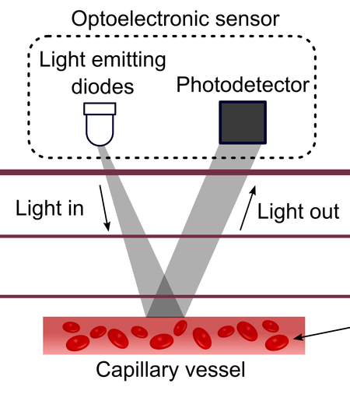
The Photoplethysmography (PPG) Technique
Measures change in blood volume
Pulse sensor emits green light from and LED onto skin
Green light is optimum for detecting blood flow
Photodetector in the sensor detect the light reflected back
Signal is amplified by Op-Amp producing signal
Signal received by photodetector is a time-varying wave-form with peaks that correspond to each heart-beat
Working principle of PPG sensors
Source: https://www.researchgate.net/figure/Working-principle-of-PPG-sensors-19_fig6_325675749
Notes:
Measures change in blood volume
Pulse sensor emits green light from and LED
Green light is optimum for detecting blood flow
Detects amount of light absorbed by blood as it flows through capillaries
As blood pulses through the capillary with each heartbeat the amount of green light absorbed changes with the volume of the blood
In systole when heart pumps there is more light absorbed and less reflected
In diastole there more green light reflected
Photodetector in the sensor detect the light reflected back from the skin
Signal is amplified by Op-Amp producing signal strong enough to be processed by the Arduino
Sensor in-cooperates a series of resistors and capacitors in a low pass filter configuration to filter unwanted frequencies
Signal received by photodetector is a time-varying wave-form with peaks that correspond to each heart-beat

Slide 3
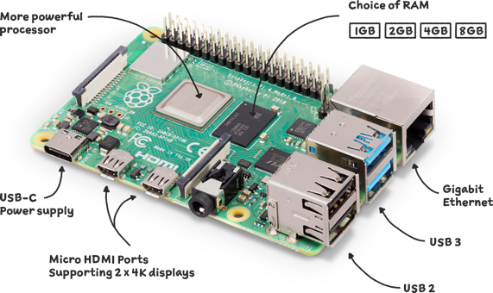
Limitations
Tradeoffs for compactness and low cost of design
Not robust enough to handle complex noise patterns
Susceptible to motion artefacts
Sensitive to ambient lighting
Lack of advanced shielding causes environmental light interference
Op-amps can also amplify the noise along with the signals
Limited processing power
No built-in wireless connection unless using Arduino Nano Every
Alternate Method
Raspberry Pi has higher processing power (full OS)
It has built in Wi-Fi and Bluetooth
Better storage and data management
Higher cost
Set up is more complex
Raspberry Pi is bulkier and consumes more energy
Raspberry Pi 4
Source: https://www.raspberrypi.com/products/raspberry-pi-4-model-b/

Slide 4
References
Pulse Rate (BPM) Monitor using Arduino & Pulse Sensor https://how2electronics.com/pulse-rate-bpm-monitor-arduino-pulse-sensor/
Liquid Crystal Displays (LCD) with Arduino https://docs.arduino.cc/learn/electronics/lcd-displays/
How to send Arduino Sensor values to Phone | Printing Real time temperature on phone using HC05 https://www.youtube.com/watch?v=jVy6Z5qA_h0

